Slide 1



Graphical Representation of Context-free Grammars
Md Dilshadur Rahman
CSC544: Advanced Data Visualization
2 December 2019

Slide 2
Problem
Graphs drawn according to the rules of some context-free grammars.
The graphs drawn from the Context-free grammar are often messy and complex.
Gets more complex with the increase of the size of the grammar.
Hard to relate the graph to the grammar rules.
Notes:
I am working on some graphs that are drawn from some context free grammars. The graphs often become messy and complex specially for the larger grammars.
So, it becomes hard to relate the graphs to the grammar rules. I am working to improve the visualization of the graphs.

Slide 3
Why visualization?
Understand and interpret large and complex grammars easily.
Understand the systems those are built using Context-free grammars.
Compiler Design and Theory of Computation researchers and students.
Notes:
Understanding the complex free grammars is very important to understand the system that are build using context free grammars. Systems like compiler, interpreter etc. are built on using context-free grammars. So, for understanding those systems, for building those systems it is important to understand CFG. For understanding CFGs, the graphs that visualize the CFGs should be understandable and relatable. Also, the researchers and students who are doing research or taking courses related to these fields, they need to understand complex free grammars clearly. So, this is obviously a visualization problem.

Slide 4
Objectives
To improve visual aspects of the graphs
To make the graphs more understandable and expressive
To enable to relate the graphs with the grammar rules easily
Notes:
To main goal of the project is to improve the visualization of the graphs. I have tried to make the graph look more clear so that the users can relate the elements of the graphs with the grammars easily.

Slide 5
Context-free Grammar(1/2)
Set of recursive rewriting rules used to generate patterns of strings.
A set of terminal symbols, which are the characters of the alphabet that appear in the strings generated by the grammar.
A set of nonterminal symbols, which are placeholders for patters of terminal symbols that can be generated by the nonterminal symbols.
A set of productions, which are rules for replacing nonterminal symbols in a string with other nonterminal or terminal symbols.
A start symbol, which is a special nonterminal symbol that appears in the initial string generated by the grammar.

Slide 6
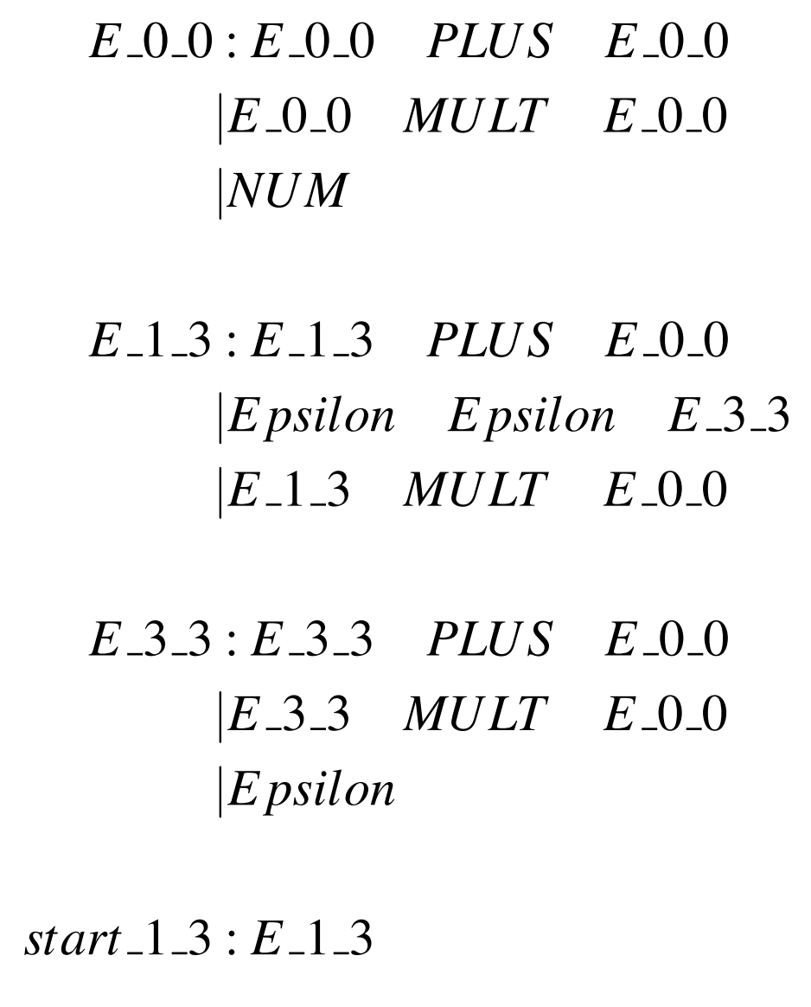
Context-free Grammar(2/2)
Notes:
Here is the context free grammar that I have been using for this presentation. The graph I have worked with is drawn from this grammar. Here we can see, the grammar has four set of grammar rules. The start_1_3 is the start symbol of the grammar and there are a lot of terminals here.

Slide 7
Data(1/3)
Input data are graphs drawn from context-free grammars.
Node-link diagrams
A set of nodes and a set of edges
Got the graphs from Dr. Strout who is a Professor at the Computer Science department at UofA
Notes:
As I have mentioned earlier, the data I am working on in this project is some graphs. So, they are some node link diagrams. That is why, they have a set of nodes and a set of edges or vertices. The nodes basically denotes the terminals and non-terminals in the grammar and the edges connecting the nodes expresses the relation among those terminals and non-terminals in the graph.

Slide 8
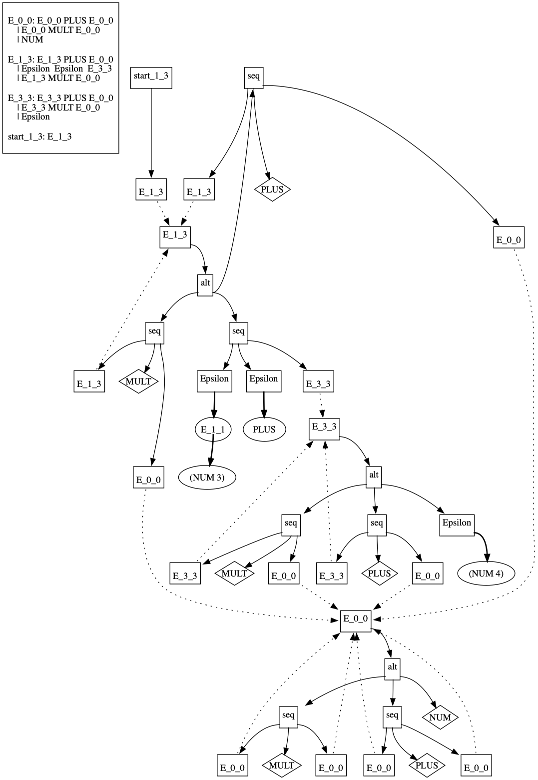
Data(2/3)
Notes:
This is the graph I have worked on. The graph is drawn from the grammar rule that we can see in the picture here. As I have mentioned already, the nodes here are representing the terminals or non-terminals in the grammars here and the edges are representing their relation. That means which terminal or non terminals originates form which ones. We can see some dotted lines in this graph. Those are for recursive calls in the grammar. But for now, I have not worked with the dotted lines in my final design. So, we don’t need to worry about those.

Slide 9
Data(3/3)
From the sample graph -
Hard to identify which node belong to which grammar rule
Hard to identify the connection among the grammar rules
Notes:
From the graph that I just showed, it is hard to identify which node belong to which grammar rule. It is also hard to separate the nodes that belong to the same grammar rule. Also, it is difficult to find out the connections among the set of grammar rules in the grammar from that graph as it is messy and complex. When the grammar gets bigger, the graph representing it also gets bigger, then it becomes even harder to relate the graphs with the grammars.

Slide 10
Initial Design Decisions
Clustering the nodes that belong to the same grammar rule
Coloring the nodes that belong to the same cluster with the same color
Followed the task taxonomy of Lee et al. as the input data are some graphs.
Notes:
So, to make things easier for the users, we thought to make some design changes in the graphs. We decided to cluster the nodes that belong to the same set of production rules in the grammar. Also, we decided to color the nodes with the same color that belong to the same set of grammar rule. As I have already mentioned that I am working with some node-link diagrams, I followed the task taxonomy of Lee et al. which is specially based on the concept of graph data.

Slide 11
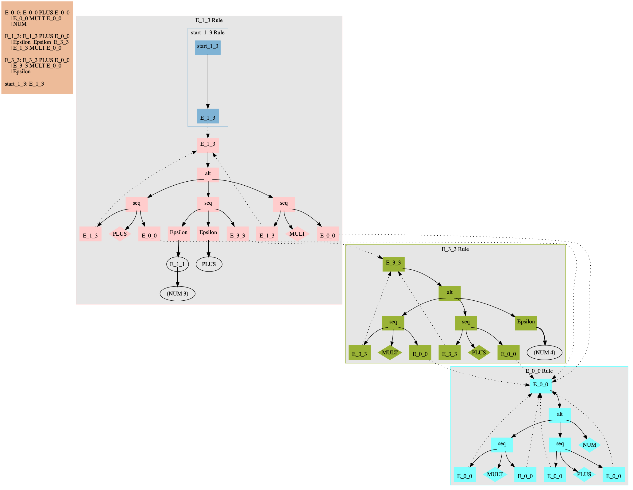
Initial Design with dot(1/2)
Notes:
Here is the finial design of my project. I have done this using dot. Dot is a graph description language which is easy to understand and work with. Here we can see four clusters. There is a nested cluster in this big cluster. So, each cluster is for each set of grammar rules in the context free grammar. We have clustered the nodes based on the grammar rules. We can also see that the nodes of the same cluster are colored with the same color. So, now we can easily understand that which nodes belong to the same cluster, which nodes belong to different clusters.

Slide 12
Initial Design with dot(2/2)
Very few design options
Not easy to add interactions using dot
Not easy to add hover operation
Not easy to add click operation, zoom/pan operations
Notes:
But, there are a few design options in dot. You can do the coloring and clustering of the nodes and edges using dot. But after the clustering and coloring of the nodes, we decided to add some interactions in the graph. But if you want to add some interaction in the visualization, you can’t do that using dot. Operations like hovering, clicking can’t be implemented using dot.

Slide 13
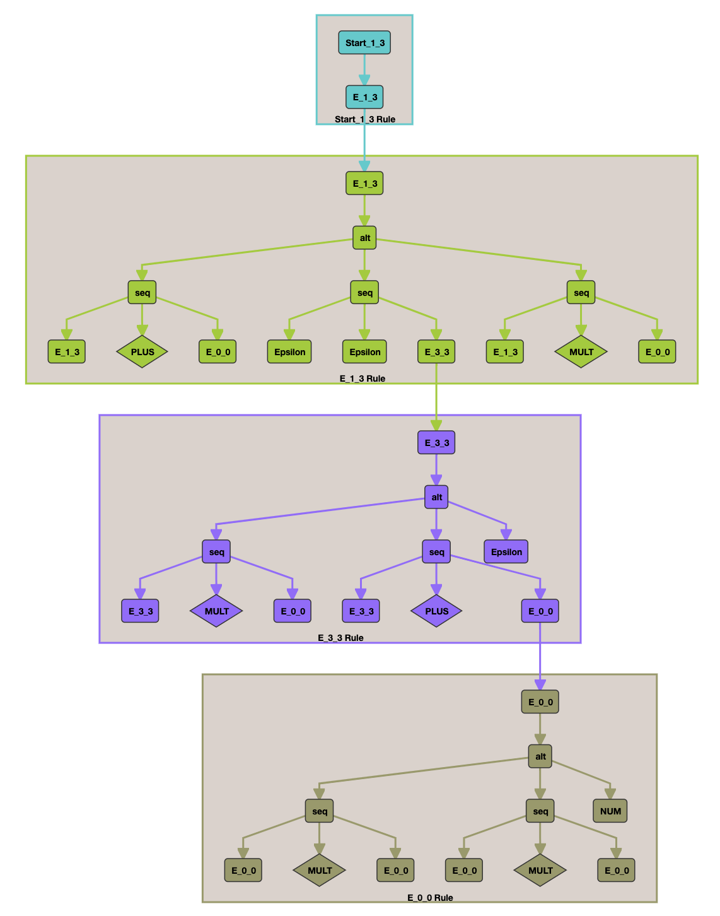
Final Design with dagre.js
Notes:
That is why, we decided to opt for something else that will help us to add the interactive operations. So, I used dagre.js which is a javascript library that enables to implement the layout of directed graphs easily on the client side. It has a renderer called dagre-d3 that helps to use d3.js with dagre.js. In this graph, we can see that it has also the 4 clusters that we have seen in the graph implemented using dot. The four clusters are for four set of rules in the grammar. The nodes of the same cluster are colored with the same color and the borders of the clusters are also of different colors so that we can differentiate specially for the large grammars where there will be a lot of clusters. The connecting edges of the clusters are colored with the color of the source cluster so that users can easily understand the relation between the clusters. The name of the clusters are named after the left hand terminal of the grammar rules.

Slide 14
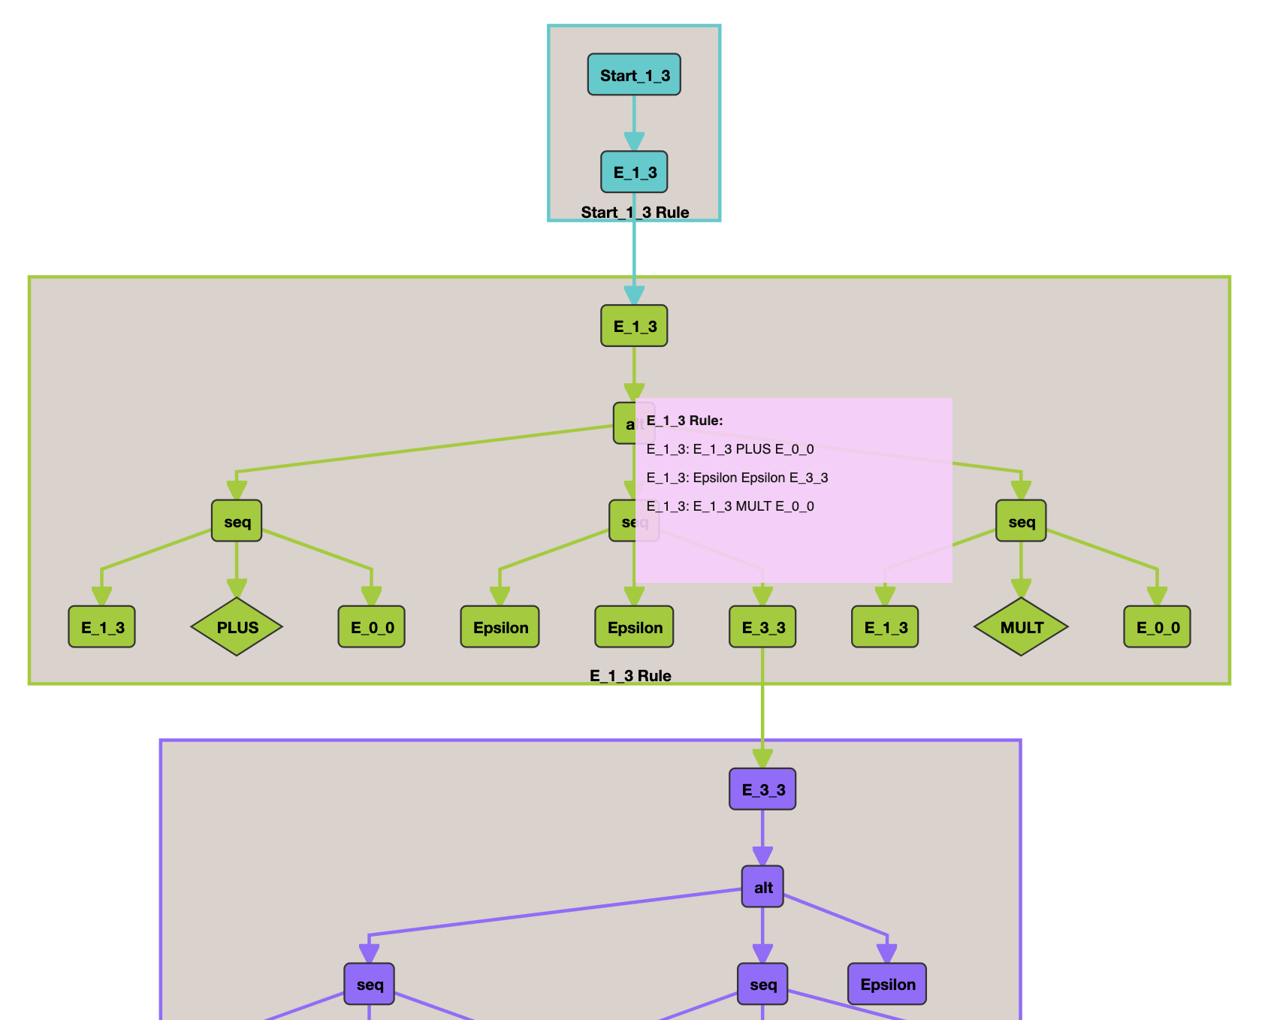
Hover operation on Nodes(1/2)
Notes:
I have implemented hover operation on the nodes. If we hover over a node a pop-up window will appear and show the associated grammar rule with that node from the grammar. By doing so, we can easily understand, which node belongs to which grammar rule in the grammar. So, relating the nodes of the graphs with the CFG will be easier than earlier.

Slide 15
Hover operation on nodes(2/2)
Easily understand the relation among the grammar rules and the nodes
In case of complex grammar, easy to relate the grammar with the graph

Slide 16
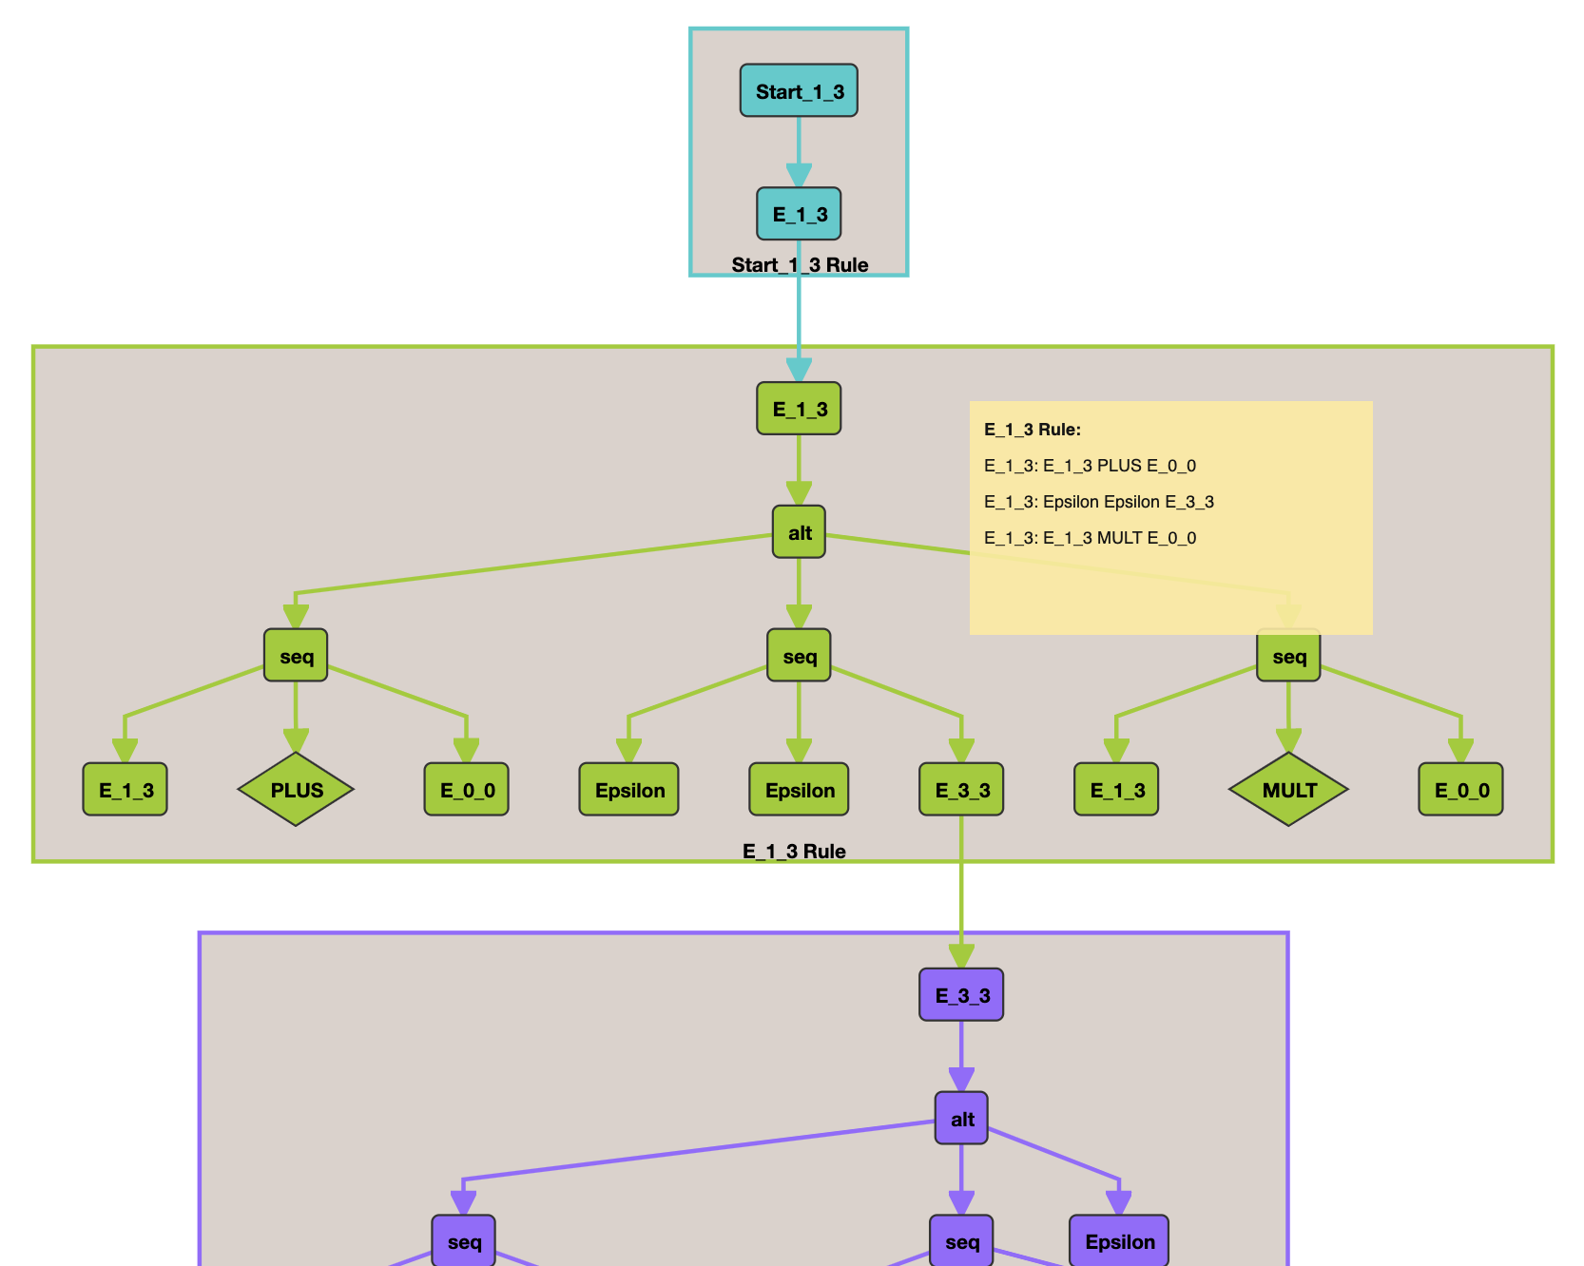
Click operation on Clusters(1/2)

Slide 17
Click operation on Clusters(2/2)
Easily understand the relation among the grammar rules and the clusters
Which cluster represents which grammar rule in the grammar
In case of large and complex grammars, easy to interpret the grammar

Slide 18
Comparison
Notes:
Here are two graphs, the left one is the graph that I have showed you earlier. This is the graph I am working on. The right one is the processed graph using darge.js. We can easily notice that the right one is clustered and colored and that is why it looks more clear than the left one. Also, in the sided graph, we can easily relate the nodes of the graph with the set of rules in the grammar. We can easily differentiate the nodes of different clusters.

Slide 19
Future Works
Work with the dotted line of the graphs
Work with the layout of the graphs
Work with the position of the nodes in the graphs
Add some more interactions if possible
Notes:
We are still working on this project. We are going to start working with the layout of the graph. We will work with the dotted lines and the position of the nodes. We have also plans to add some more interaction to make the graphs more understandable and expressive for the users.

Slide 20
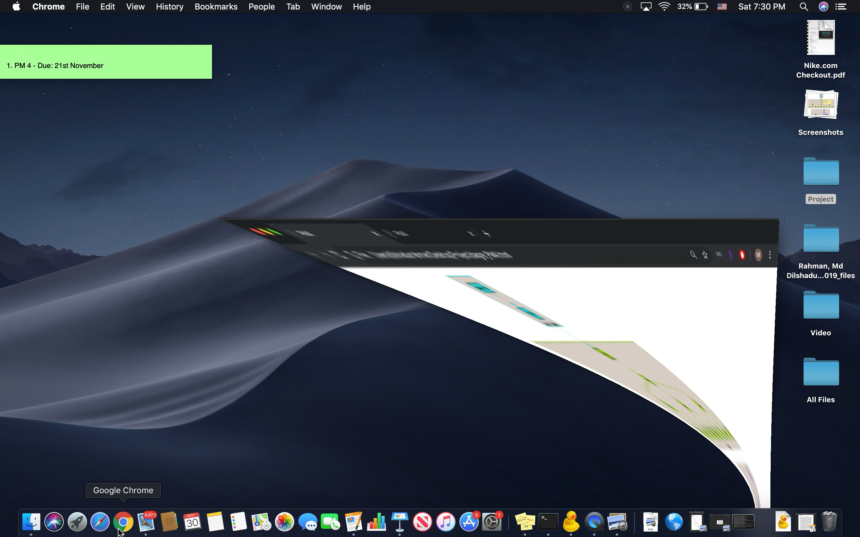
Demo
Notes:
Here is the demo of my project. First we can see the layout that is implemented using dagre.js. Here the second graph is done using Cola.js. I tried to cola.js which is also a javascript graph drawing library. But I faced some difficulties to render the actual treelike layout of the graph.

Slide 21
Thank you :)
Any Questions?

